Slide 1
Lending Club Case Study
PRESENT BY
KARAN SINGH BISHT
Surendra Babu Kunka

Slide 2
AGENDA
PROBLEM STATEMENT
DATA CLEANING
ANALYSIS
FINDINGS

Slide 3
Problem statement
You work for a consumer finance company which specialises in lending various types of loans to urban customers. When the company receives a loan application, the company has to make a decision for loan approval based on the applicant’s profile.
Two types of risks are associated with the bank’s decision:
If the applicant is likely to repay the loan, then not approving the loan results in a loss of business to the company
If the applicant is not likely to repay the loan, i.e. he/she is likely to default, then approving the loan may lead to a financial loss for the company

Slide 4
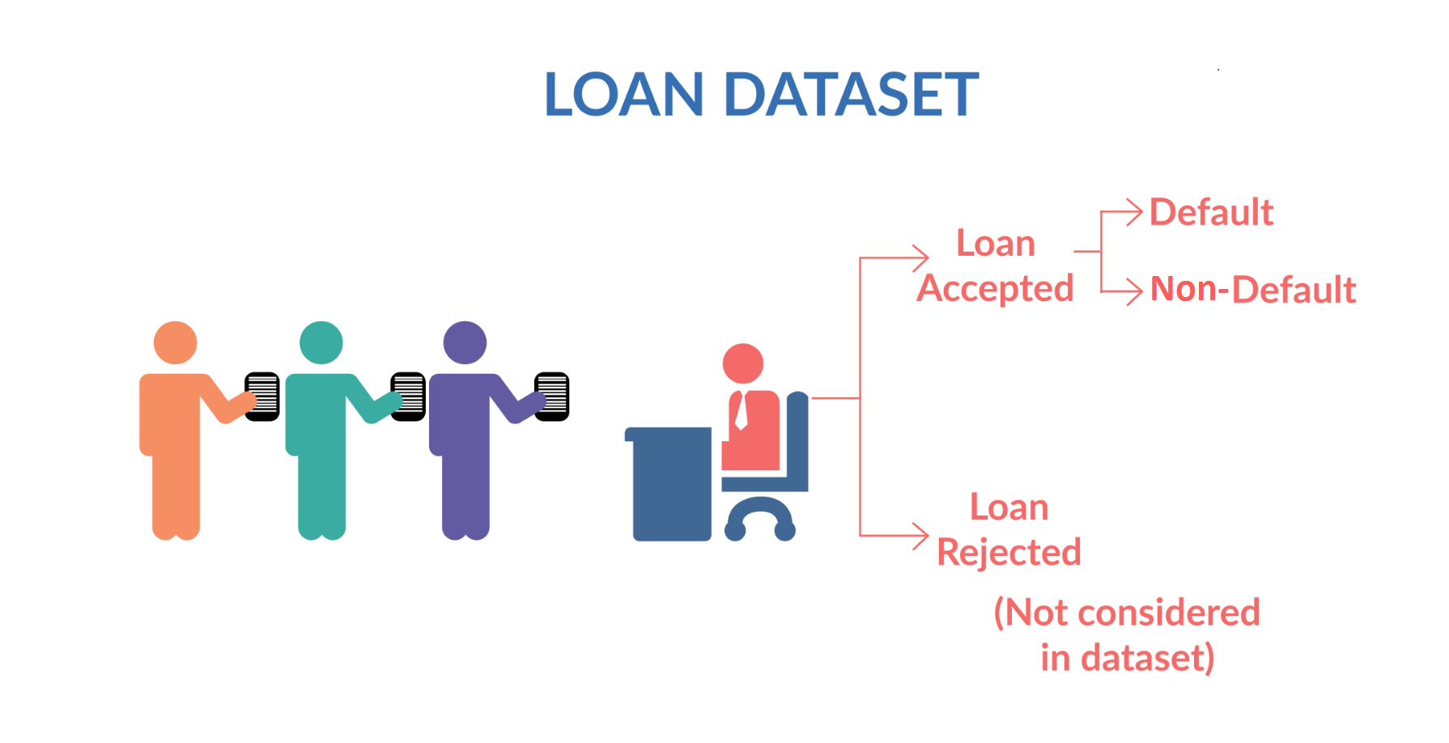
Loan dataset

Slide 5
DATA CLEANING
Need to fix rows and columns
Drop columns which not required
Need to fix missing values
Derived Columns

Slide 6
ANALYSIS
AFTER CLEANING THE DATA WE CAN USE THESE TWO ANALYSIS TO UNDERSTAND THE DATA
1. Univariate analysis
2. Bivariate analysis

Slide 7
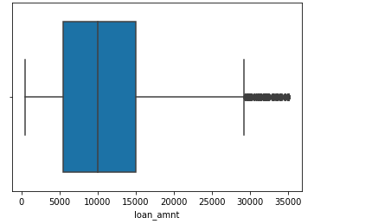
Univariate analysis Mostly people taking loan between 5k to 15 k

Slide 8
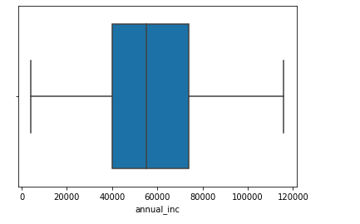
As per annual income people those are interested in Loan

Slide 9
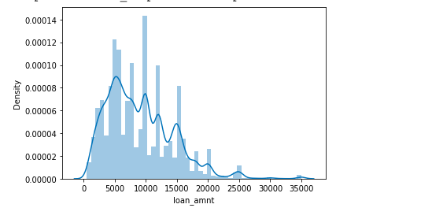

Slide 10
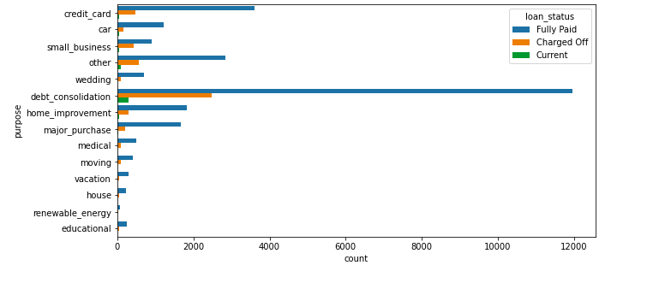
On the basis of purpose why people taking loan

Slide 11
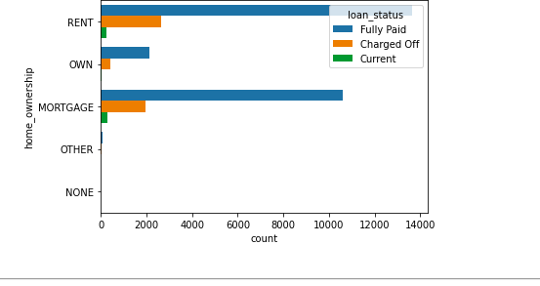
People those are living on rent are more interested on loan

Slide 12
Acording to state where people taking more loan

Slide 13
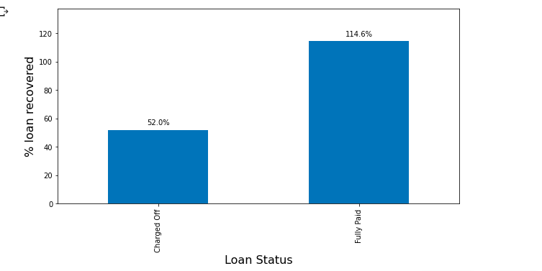
Observation: 52 % Loan amount is recovered from defaulters

Slide 14
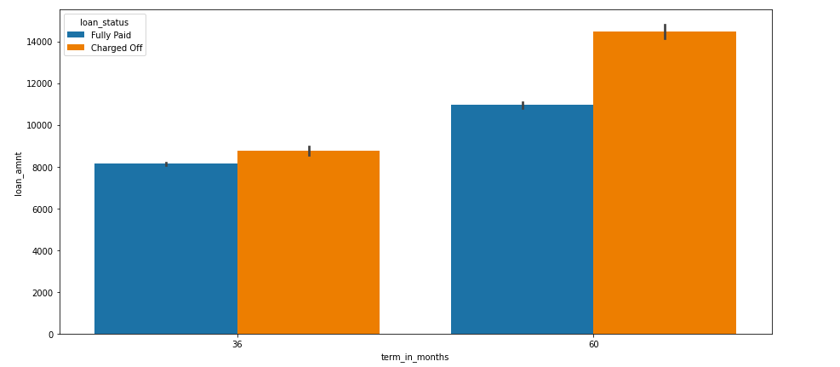
Bivariate analysis Observation: As per the analysis, Higher the term and loan amount, higher Charged off's

Slide 15
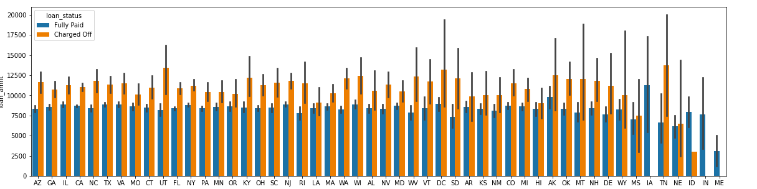
Observation : State Ak has Higher loan amount that is charged off

Slide 16
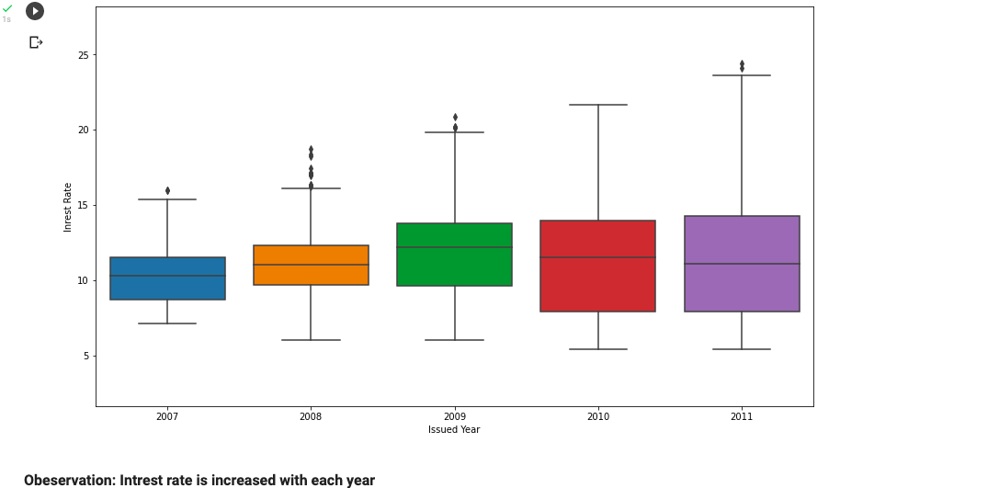
Observation: Interest rate is increased with each year

Slide 17
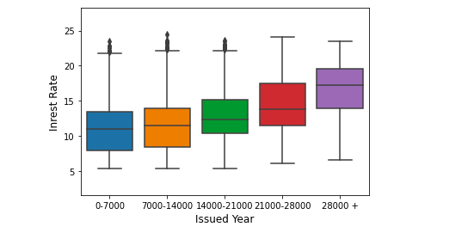
Observation: Intrest rate is also increased when Loan amount increase

Slide 18
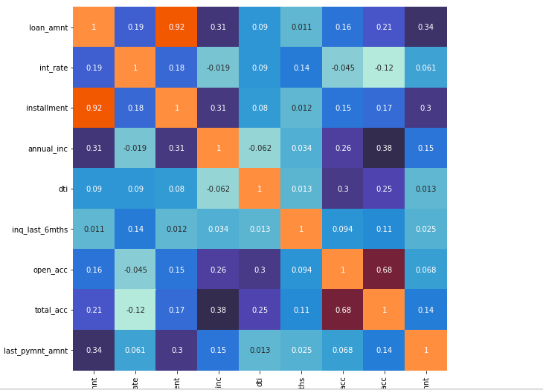
Observation: Loan amount and installment has high correlation Annual Income and int_rate has negative correlation

Slide 20
THANK YOU!

